Slide 1
Question 2a

Slide 2

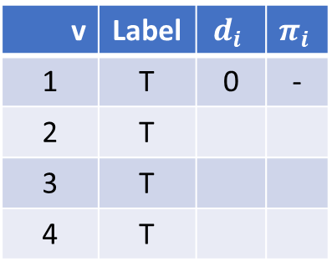

$$i$$
Permanent
-
$$i$$
Temporary
∞
-
2
-
v | Label | $$d_{i}$$ | $$π_{i}$$
1 | T | 0 | -
2 | T
3 | T
4 | T
2
4
0
∞
1
4
1
3
3
2
-
∞

Slide 3
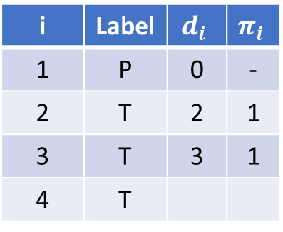
$$i$$
Permanent
1
$$i$$
Temporary
2
-
2
-
i | Label | $$d_{i}$$ | $$π_{i}$$
1 | P | 0 | -
2 | T | 2 | 1
3 | T | 3 | 1
4 | T
2
4
0
∞
1
4
1
3
3
2
1
3

Slide 4
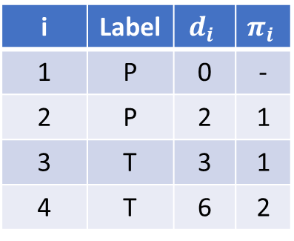
$$i$$
Permanent
1
$$i$$
Temporary
2
-
2
2
i | Label | $$d_{i}$$ | $$π_{i}$$
1 | P | 0 | -
2 | P | 2 | 1
3 | T | 3 | 1
4 | T | 6 | 2
2
4
0
6
1
4
1
3
3
2
1
3

Slide 5
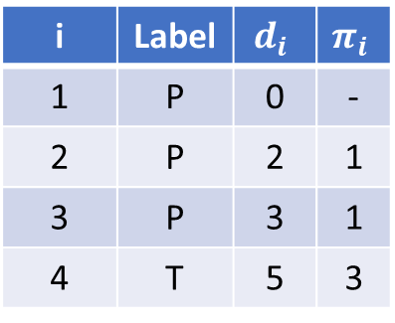
$$i$$
Permanent
1
$$i$$
Temporary
2
-
2
3
i | Label | $$d_{i}$$ | $$π_{i}$$
1 | P | 0 | -
2 | P | 2 | 1
3 | P | 3 | 1
4 | T | 5 | 3
2
4
0
5
1
4
1
3
3
2
1
3

Slide 6

$$i$$
Permanent
1
$$i$$
Temporary
2
-
2
3
i | Label | $$d_{i}$$ | $$π_{i}$$
1 | P | 0 | -
2 | P | 2 | 1
3 | P | 3 | 1
4 | P | 5 | 3
2
4
0
5
1
4
1
3
3
2
1
3

Slide 7
$$i$$
Permanent
1
$$i$$
Temporary
2
-
2
3
i | Label | $$d_{i}$$ | $$π_{i}$$
1 | P | 0 | -
2 | P | 2 | 1
3 | P | 3 | 1
4 | P | 5 | 3
2
4
0
5
1
4
1
3
3
2
Shortest Path found by working backwards from node 4 and following the predecessors
(1,3,4) with a total of 5
1
3

Slide 8
Question 2b

Slide 9
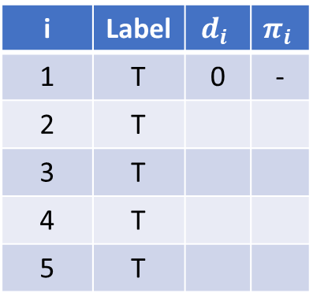
$$i$$
Permanent
-
∞
$$i$$
Temporary
-
2
15
∞
i | Label | $$d_{i}$$ | $$π_{i}$$
1 | T | 0 | -
2 | T
3 | T
4 | T
5 | T
4
-
100
20
50
0
10
1
30
3
60
5
-
-
∞
∞

Slide 10
$$i$$
Permanent
$$i$$
Temporary
2
15
i | Label | $$d_{i}$$ | $$π_{i}$$
1 | T | 0 | -
2 | T
3 | T
4 | T
5 | T
4
100
20
50
10
1
30
3
60
5

Slide 11
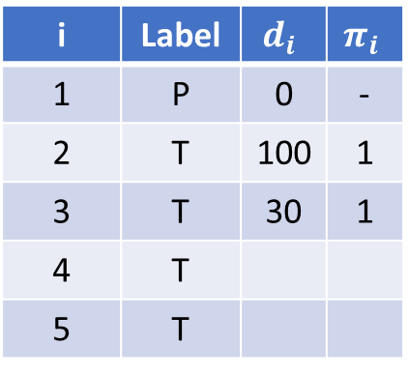
$$i$$
Permanent
1
100
$$i$$
Temporary
-
2
15
∞
i | Label | $$d_{i}$$ | $$π_{i}$$
1 | P | 0 | -
2 | T | 100 | 1
3 | T | 30 | 1
4 | T
5 | T
4
-
100
20
50
0
10
1
30
3
60
5
1
-
30
∞

Slide 12
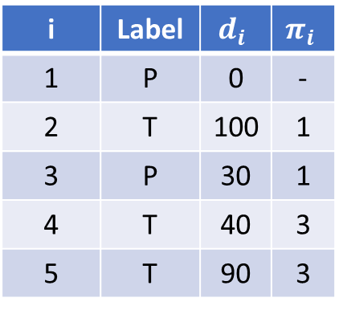
$$i$$
Permanent
1
100
$$i$$
Temporary
3
2
15
40
i | Label | $$d_{i}$$ | $$π_{i}$$
1 | P | 0 | -
2 | T | 100 | 1
3 | P | 30 | 1
4 | T | 40 | 3
5 | T | 90 | 3
4
-
100
20
50
0
10
1
30
3
60
5
1
3
30
90

Slide 13
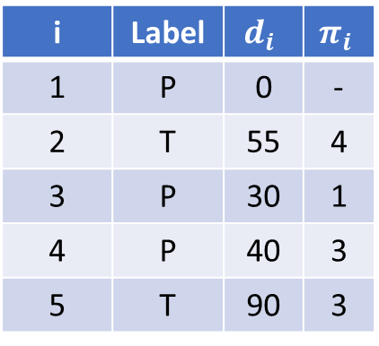
$$i$$
Permanent
4
55
$$i$$
Temporary
3
2
15
40
i | Label | $$d_{i}$$ | $$π_{i}$$
1 | P | 0 | -
2 | T | 55 | 4
3 | P | 30 | 1
4 | P | 40 | 3
5 | T | 90 | 3
4
-
100
20
50
0
10
1
30
3
60
5
1
3
30
90

Slide 14
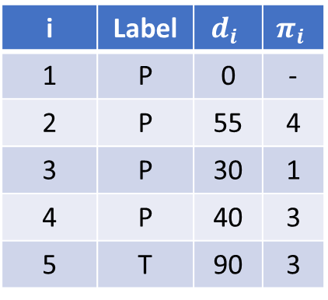
$$i$$
Permanent
4
55
$$i$$
Temporary
3
2
15
40
i | Label | $$d_{i}$$ | $$π_{i}$$
1 | P | 0 | -
2 | P | 55 | 4
3 | P | 30 | 1
4 | P | 40 | 3
5 | T | 90 | 3
4
-
100
20
50
0
10
1
30
3
60
5
1
3
30
90

Slide 15

$$i$$
Permanent
4
55
$$i$$
Temporary
3
2
15
40
i | Label | $$d_{i}$$ | $$π_{i}$$
1 | P | 0 | -
2 | P | 55 | 4
3 | P | 30 | 1
4 | P | 40 | 3
5 | P | 90 | 3
4
-
100
20
50
0
10
1
30
3
60
5
1
3
30
90
Shortest Path found by working backwards from node 2 and following the predecessors
(1,3,4,2) with a total of 55

